Slide 1




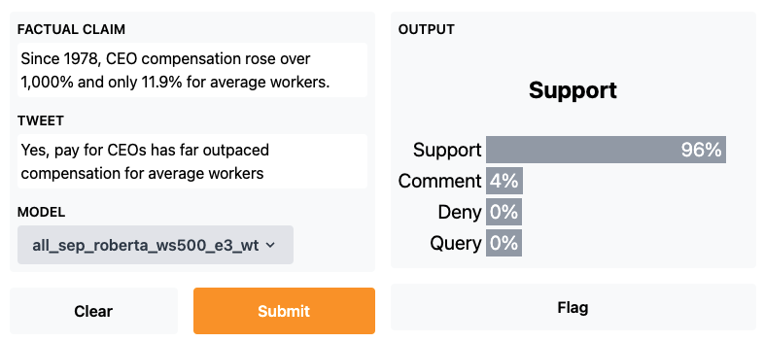
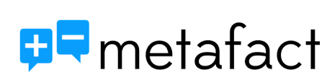



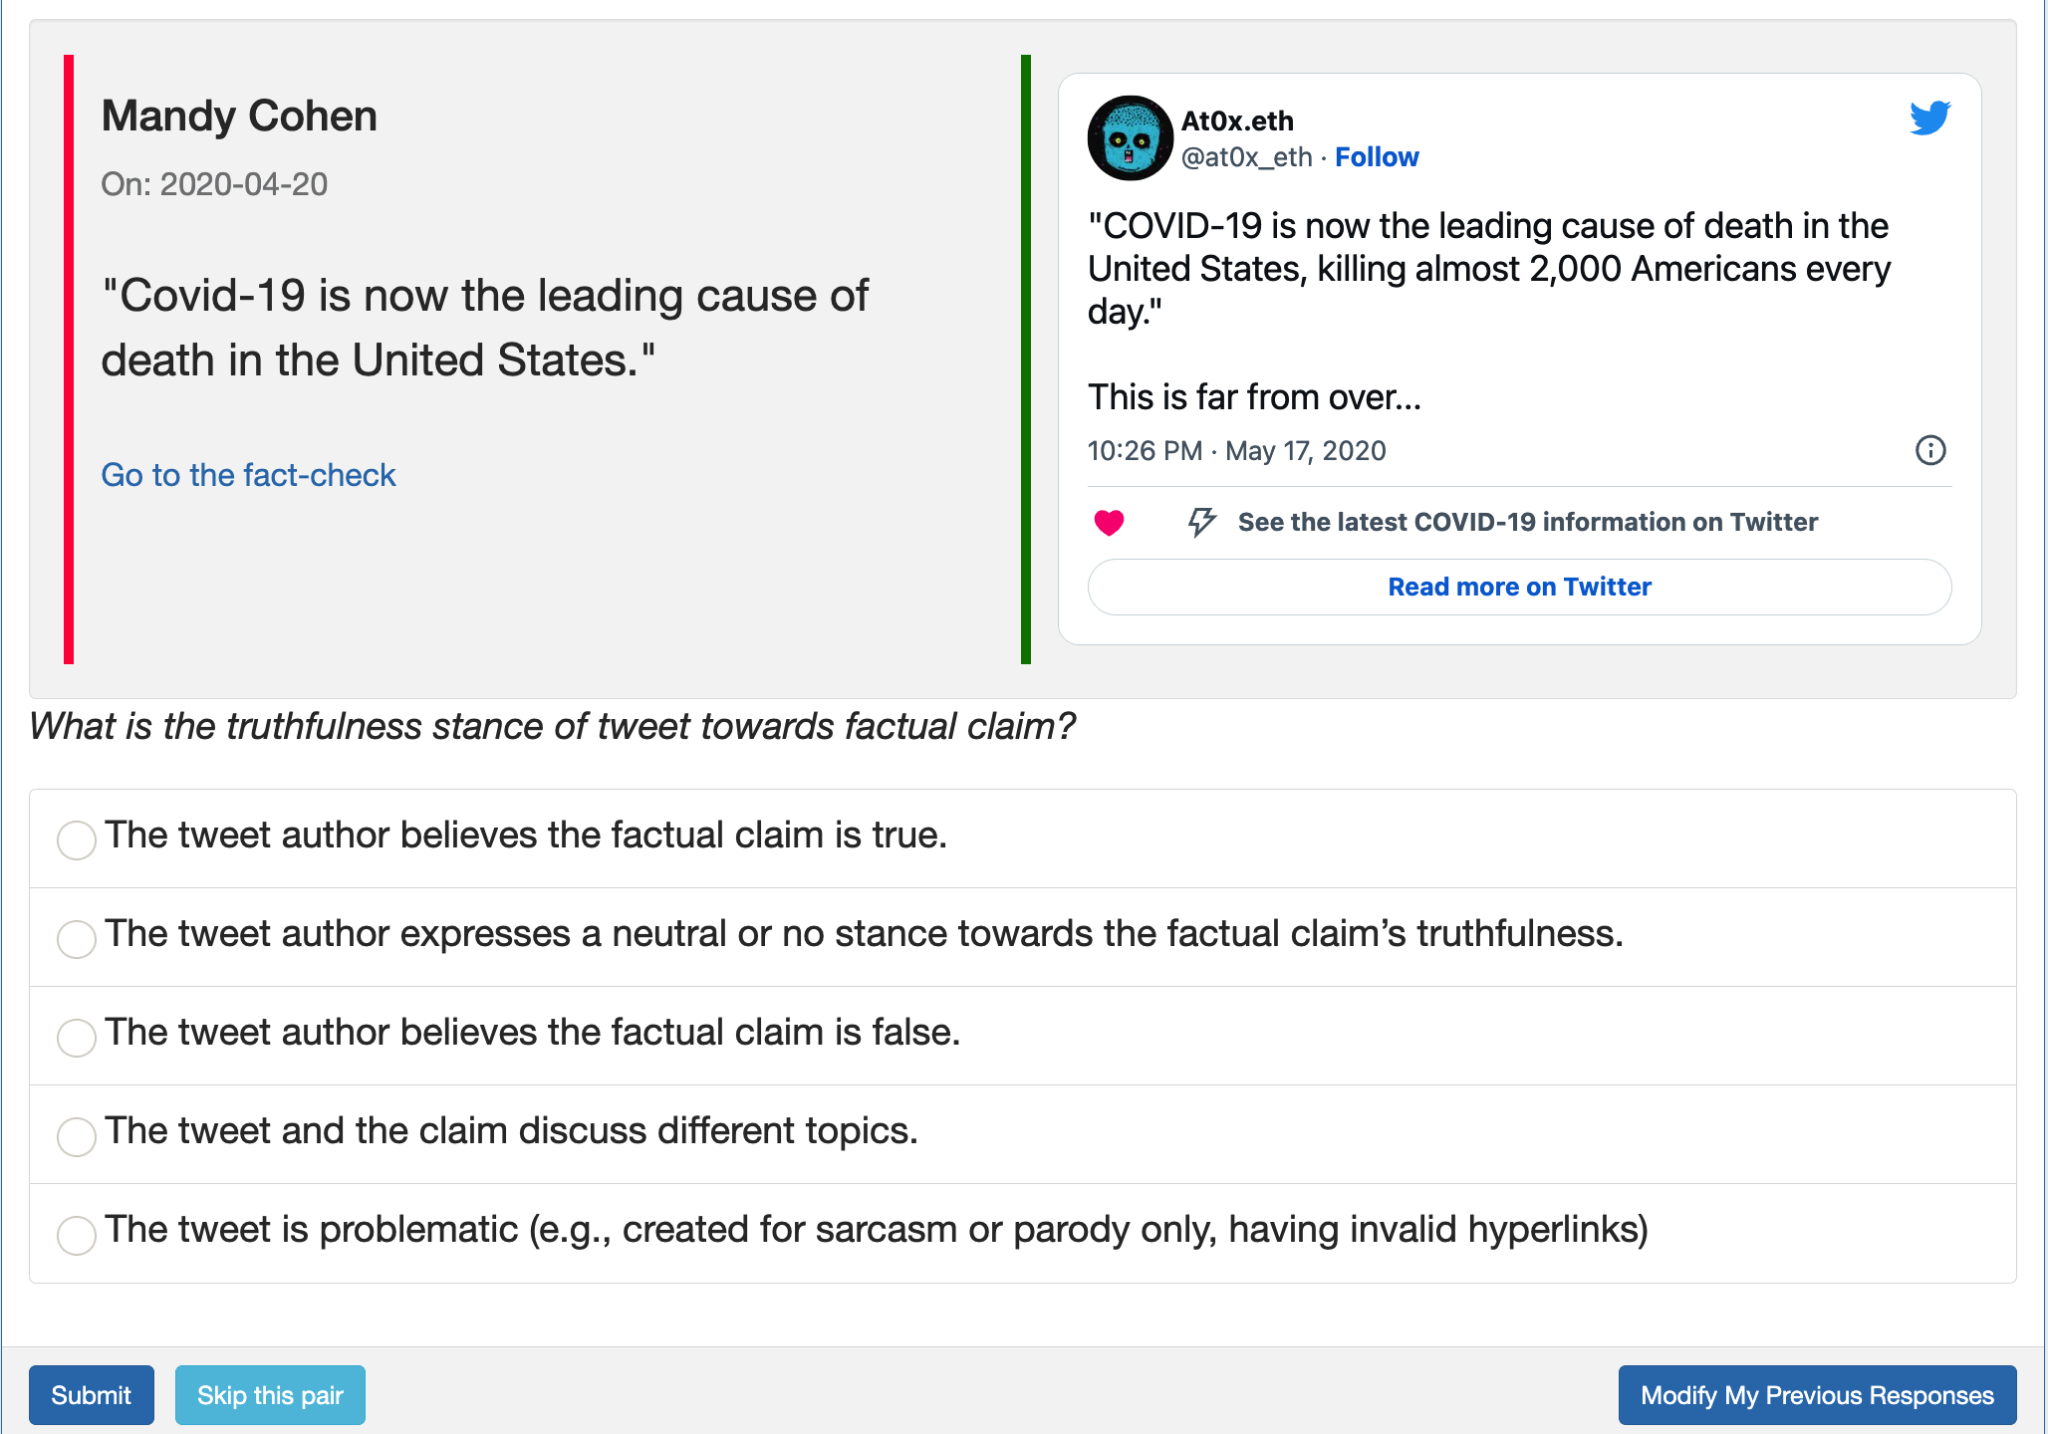
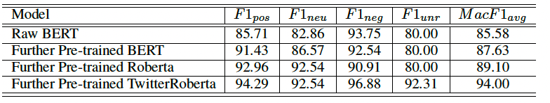
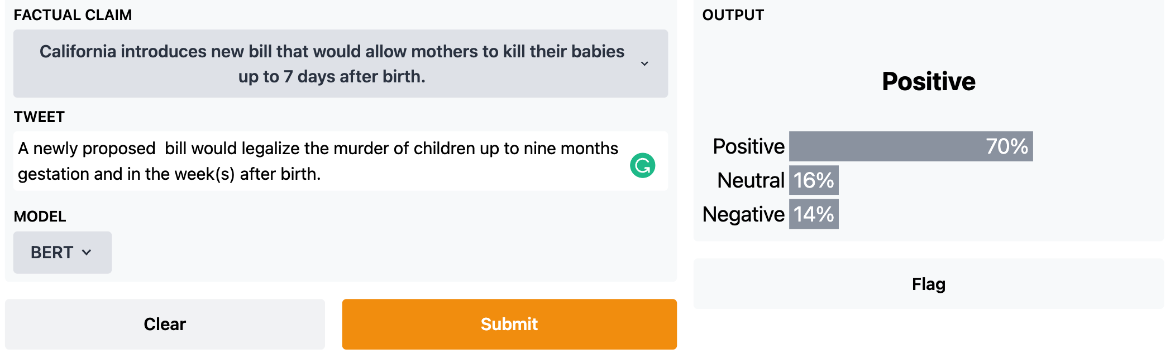
Detecting Stance of Tweets Toward Truthfulness of Factual Claims
Student Computing Research Festival (SCRF) 2023
Zhengyuan Zhu Zeyu Zhang Foram Pankajbhai Patel Josue Caraballo
Advisor: Chengkai Li
Innovative Data Intelligence Research Laboratory
Annotation System: idir.uta.edu/wildfire_annotation/ Stance Detection Demo: idir.uta.edu/stance_detection
The Emphasis on Truthfulness Stance Detection
The stance refers to a Twitter user’s belief regarding the truthfulness of a factual claim
The target of stance is a factual claim rather than a topic, or a subject
Tweet: 0.05% chance of dying from covid isn’t exactly deadly! 😂
believe the claim is true
Factual Claim: There is a 0.05% chance of dying from COVID.
Tweet: Again you ONLY have a 0.05% chance of dying from covid if you are SEVENTY or younger!
believe the claim is false
The Methodology of Truthfulness Stance Detection on Tweet-claim Pairs
Fact-check Collection
Fact-check Collection
Keyword Queries
Tweet Collector
Twitter API
Tweets
Tweet Collector
Twitter API
Tweets
Fact-checks
Fine-tuned Further Pretrained Model
Fact-checks
Fine-tuned Further Pretrained Model
Factual Claims
Fine-tuning
Factual Claims
Claim-tweet Pairs
Fine-tuning
Reviews
Reviews
Pretrained Language Model
Further Pretrained Language Model
Pretrained Language Model
Further pre-training
Further Pretrained Language Model
Further pre-training
Data Collection: Factual Claims, Tweets and Stance Dataset
Data Collection: Stance Detection Annotation System
Factual claims
Tweets
Machine Learning Model
Built a daily fact check collection tool
52,805 factual claims from seven fact-checking websites
Used claim keywords and twitter academic research API to collect tweets.
65,011 distinct claim related tweets from 2007 to 2022
Claim-Post Pairs
Annotation
Stance Detection Dataset
Training
Performance of Truthfulness Stance Detection
Truthfulness Stance Detection Demo

